Slide 1
CT Brain
DR: Hayam Abdelmonsif

Slide 2
Indications:
Acute head trauma/ Suspected acute intracranial hemorrhage.
Immediate postoperative evaluation following brain surgery.
Suspected shunt malfunctions.
Mental status change.
Headache.
Suspected hydrocephalus.
Drug toxicity.
Suspected mass or tumor.
Seizures.

Slide 3
Patient preparation
Each patient is given an explanation of the procedure for their individual scan on being brought into the scan room.
It is important to explain the need for the head rest and any immobilizing straps and pads.
Ensure that the patient is comfortable; use knee supports and pillows if necessary.
In apprehensive patients may be shown around the scanner when they come to make their appointment. This can be particularly helpful with children.

Slide 4
Patient preparation
Women in child bearing period ( ? Pregnant )
Explain and consent, from 16 years up or their parents
Bowel preparation?
Previous films and notes
If risk of bleeding … coagulation profile
Premedication …(non cooperative patient with painful procedure).
If CM to be used: Fasting (4hs … children, 6 hrs … adult), Serum creatinine.

Slide 5
Technique
Routine brain scan:
Patient position: Supine, head in head rest, scanner gantry parallel to radiographic baseline (RBL).
Head in Centre of scan field.
Scanorgram : Lateral scan projection radiograph
Frontal scan projection radiograph in some machines
Scan start position: 1cm inferior to skull base
End of scan: end of skull vault (vertex).

Slide 6
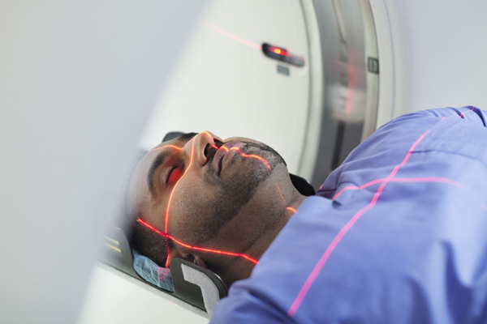

Slide 7
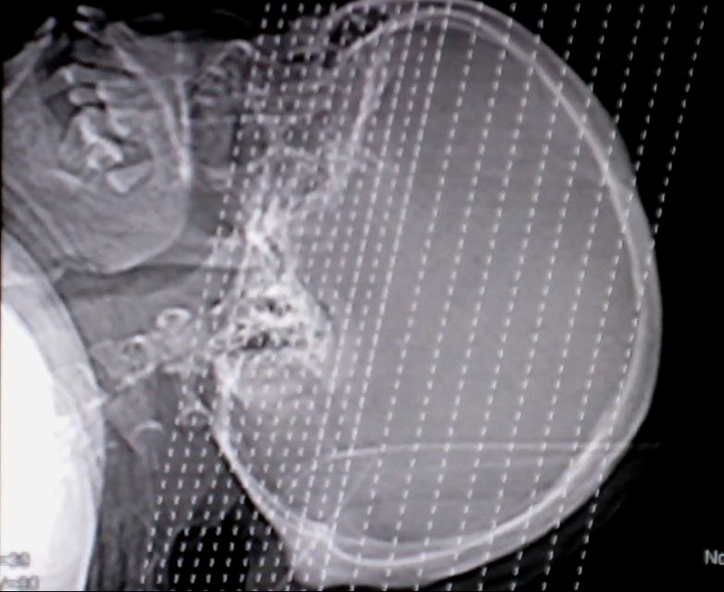

Slide 8
Protocol
Slice thickness : 10 mm
Table increment : 10 mm
Kilovoltage : 120 kV
mAs per slice: 300 mAs
Algorithm : Standard
Scan field of view : 25 cm
Display field of view : 25 cm
Window width (WW) : 80
Window level (WL) : 40

Slide 9
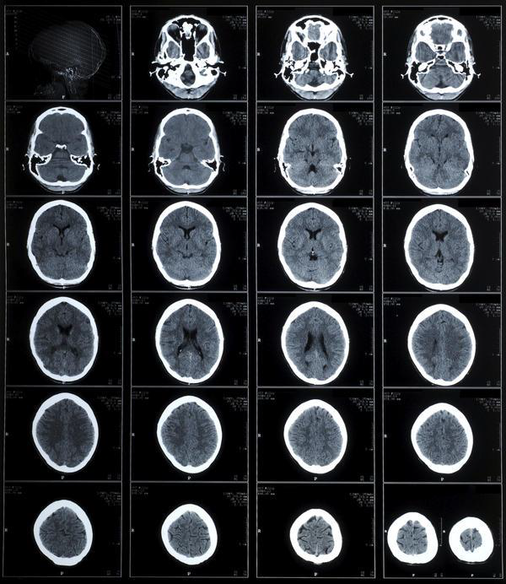

Slide 10
Technique
Adapting technique to the pathology and the patient
THE POSTERIOR FOSSA
When the clinical information clearly indicates a posterior fossa or mid-brain pathology the slice width and table incrimination are adjusted to 5 mm (or in some cases 3 mm) to better demonstrate these areas.
It may be necessary to adjust the mAs per slice to 320 mAs to obtain a comparable image quality.
Begin the scan 1 cm below and parallel to the RBL.

Slide 11
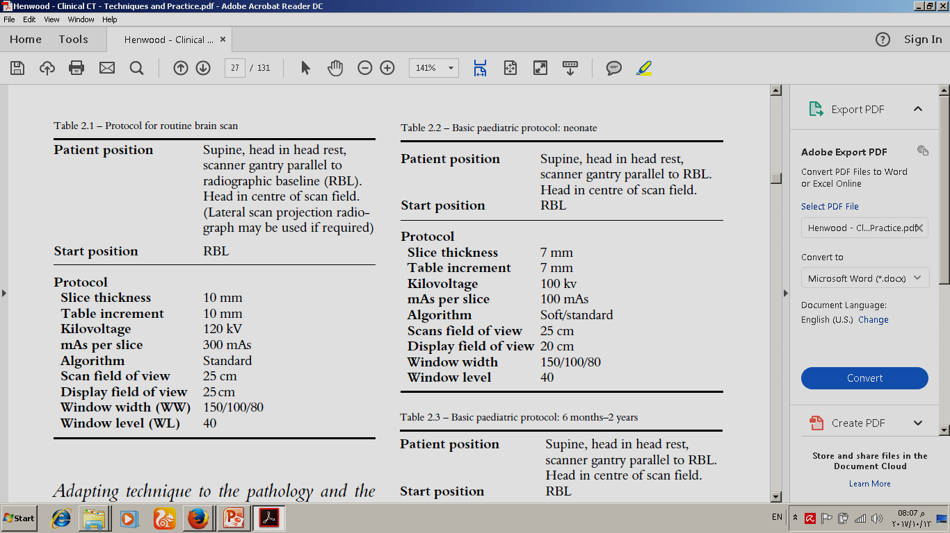
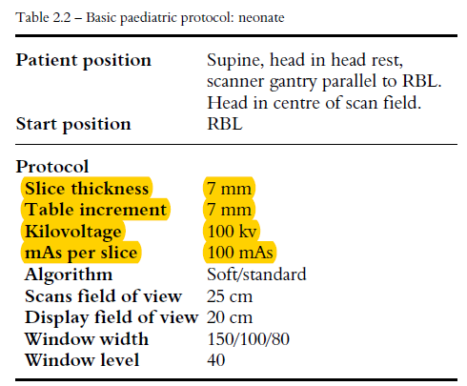
Technique
Adapting technique to the pathology and the patient

Slide 12
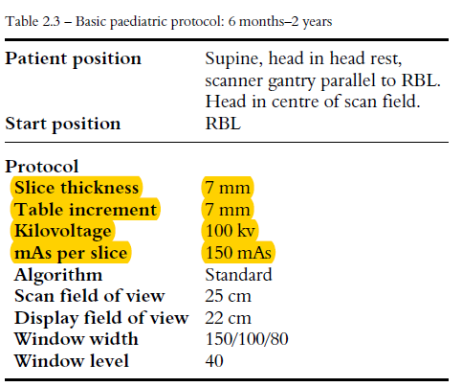
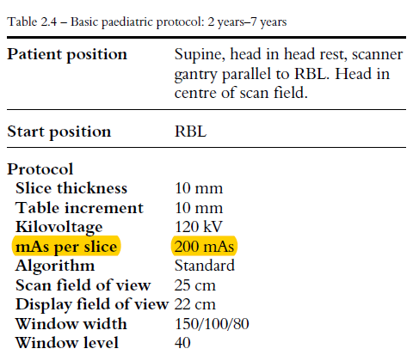
Technique
Adapting technique to the pathology and the patient

Slide 13
Technique
Adapting technique to the pathology and the patient
TRAUMA:
Presentations are widely variable and the scan must be tailored to the individual case.
If there is evidence of facial injury it is appropriate to perform scans of the facial skeleton at the same time, as this will assist the maxillofacial surgeon’s assessment of injury.
In cases of multiple trauma it may be appropriate to perform a lateral scan projection radiograph of the cervical spine to better assess the C7/T1 area. This should be done using high kV and mA values to produce an image where the available information can be manipulated to produce optimal visualization

Slide 14
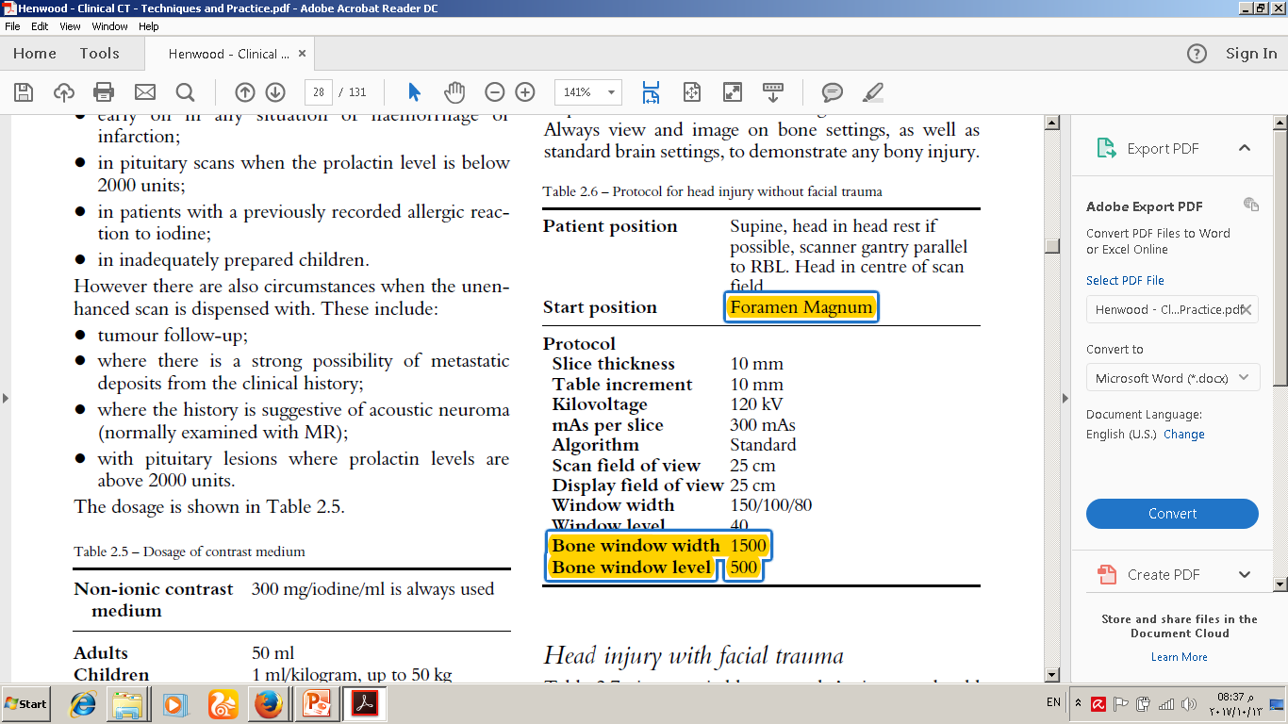
Technique
Adapting technique to the pathology and the patient
HEAD INJURY WITHOUT FACIAL TRAUMA:
Always view and image on bone settings, as well as standard brain settings, to demonstrate any bony injury

Slide 15
Technique
Adapting technique to the pathology and the patient
HEAD INJURY WITH FACIAL TRAUMA:
Always view and image on bone settings, as well as standard brain settings, to demonstrate any bony injury
Scans are from the frontal sinus through the hyoid bone to include both the mandible and the facial bones. Scanning is acquired at sub-millimeter thickness to generate high-quality multiplanar reformations and 3-D reconstructions

Slide 16
Technique
Adapting technique to the pathology and the patient
HEAD INJURY WITH FACIAL TRAUMA:
Always view and image on bone settings, as well as standard brain settings, to demonstrate any bony injury
CT images are reviewed at 2-mm thick reformations oriented parallel and perpendicular to the hard palate to achieve symmetry in both the transverse and coronal planes. Sagittal images are also generated for review. All images are processed using bone and soft tissue algorithms. Additional oblique or curved reformations and 3-D reconstructions are generated according to the area of interest on a case by- case basis.

Slide 17
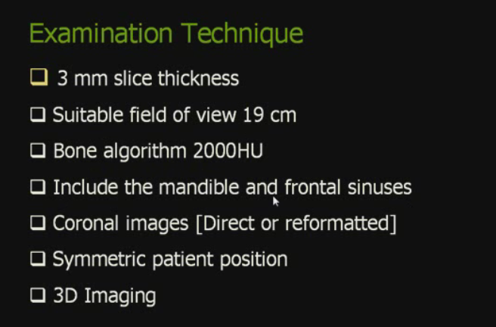
Technique
Adapting technique to the pathology and the patient
HEAD INJURY WITH FACIAL TRAUMA:
Always view and image on bone settings, as well as standard brain settings, to demonstrate any bony injury

Slide 18
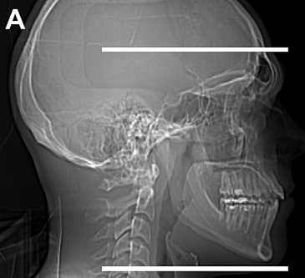
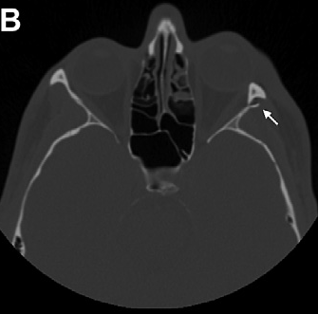
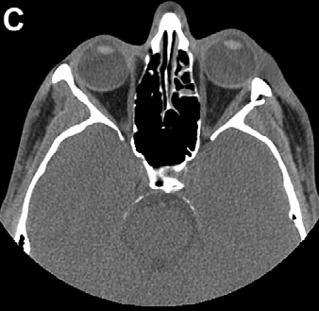
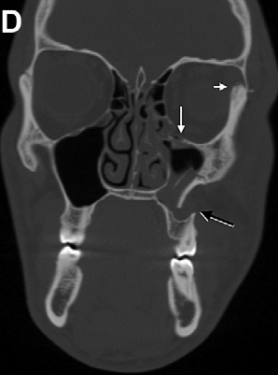
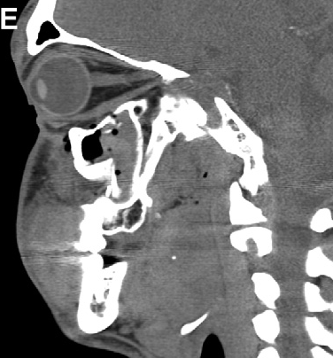
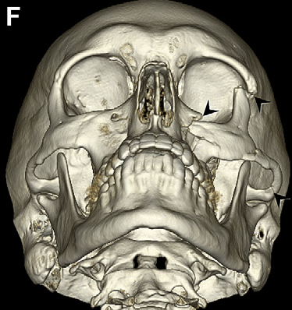

Slide 19
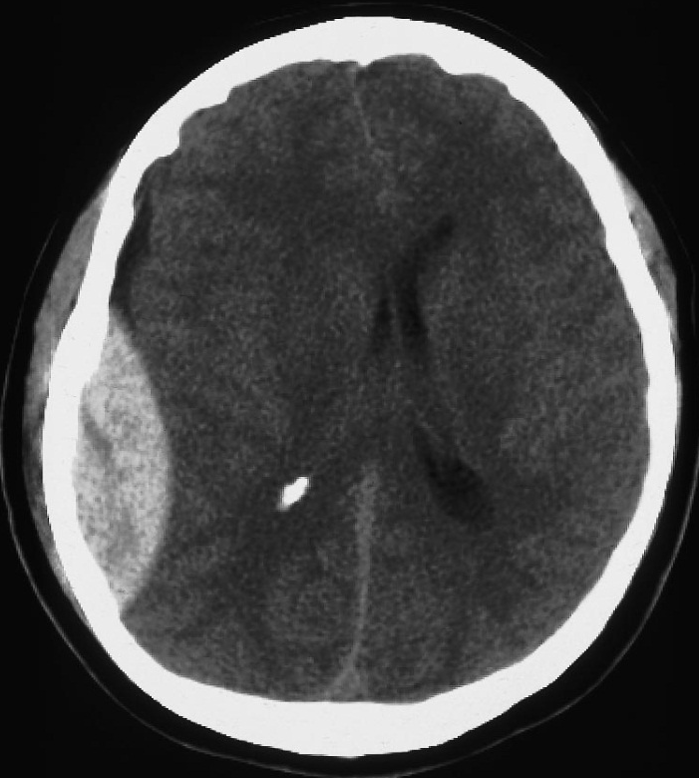
Technique
Adapting technique to the pathology and the patient
ACUTE HEMORRHAGE
A routine brain scanning protocol is used.
Note that no contrast medium should be
administered in the acute phase.
Most subarachnoid haemorrhage and some
intracerebral haemorrhage patients will undergo
diagnostic cerebral angiography to clarify the findings
of the CT scan and prior to possible surgery,
or endovascular embolization.

Slide 20
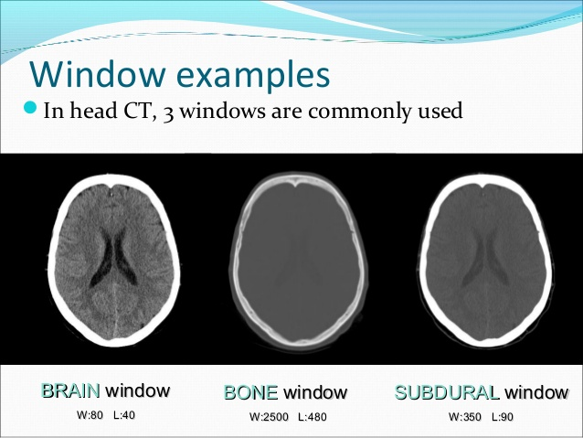

Slide 21
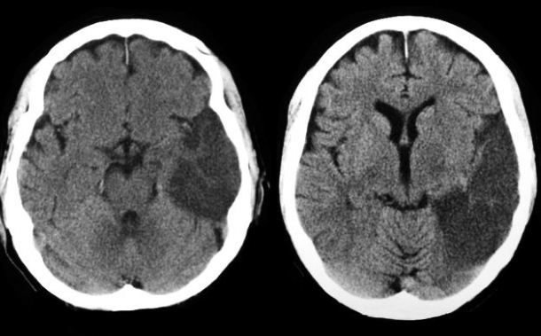
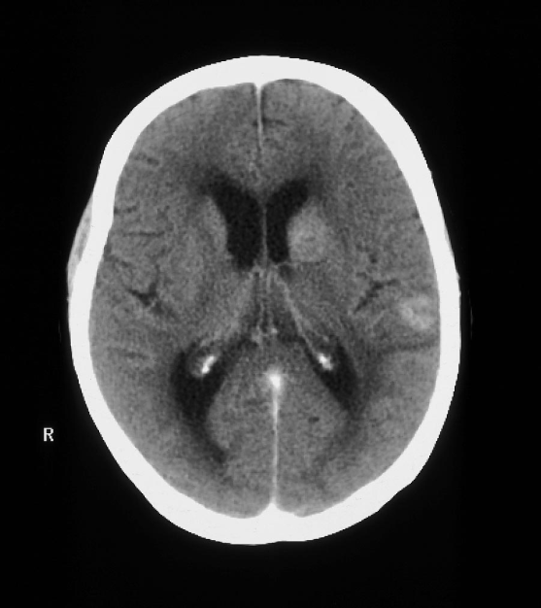
Technique
Adapting technique to the pathology and the patient
INFARCTION:
Routine study
BRAIN TUMORS AND INFECTION:
A routine brain scan protocol is employed,
before and after administration of
IV contrast medium.

Slide 22
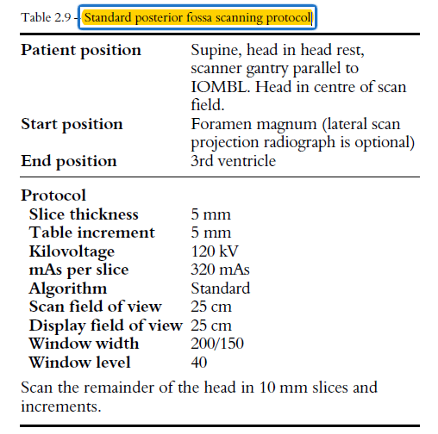
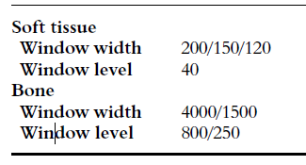
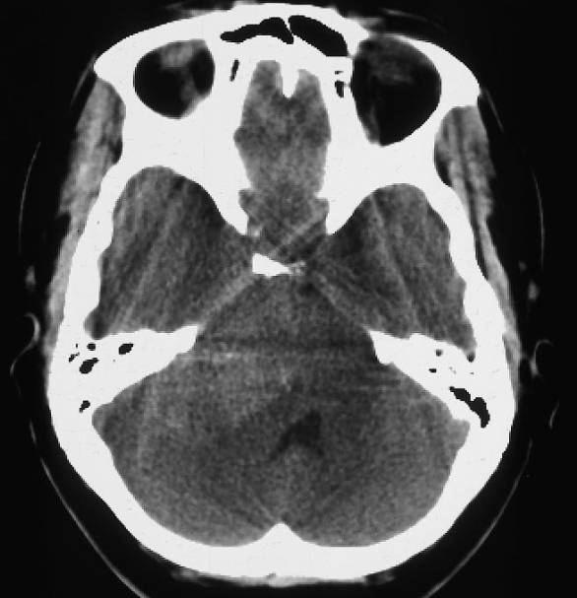
Technique
Adapting technique to the pathology and the patient
POSTERIOR FOSSA

Slide 23
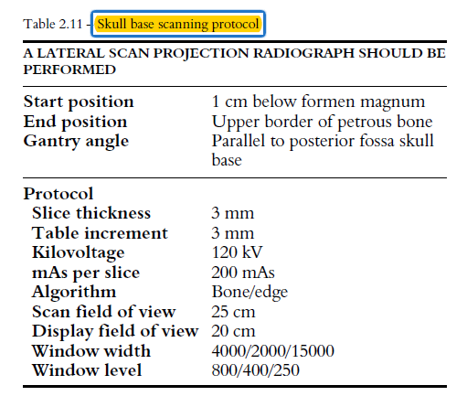
Technique
Adapting technique to the pathology and the patient
SKULL BASE
CT imaging of the bone erosion or destruction of skull base tumours is needed as an adjunct to MRI.
If MR imaging has not been performed it will be necessary to perform the CT scan with contrast and use a higher mAs setting; this is in order to post process into a soft tissue or standard algorithm to assess the soft tissue component of these types of lesions.

Slide 24
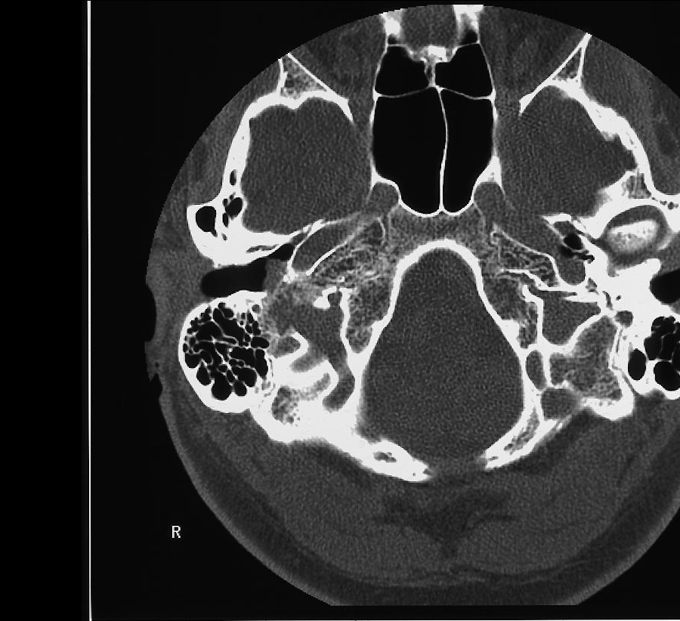

Slide 25
CT images must be reviewed using multiple windows and levels
brain W:80 L:40 [80/40]
subdural W:130-300 L:50-100 [150/75]
stroke W:8 L:32 or W:40 L:40 [32/8]
Bone W: 1500 L: 500 [1500/500]
temporal bones W:2800 L:600 [3000/600]
soft tissues: W:350–400 L:20–60 [350/35]

Slide 26
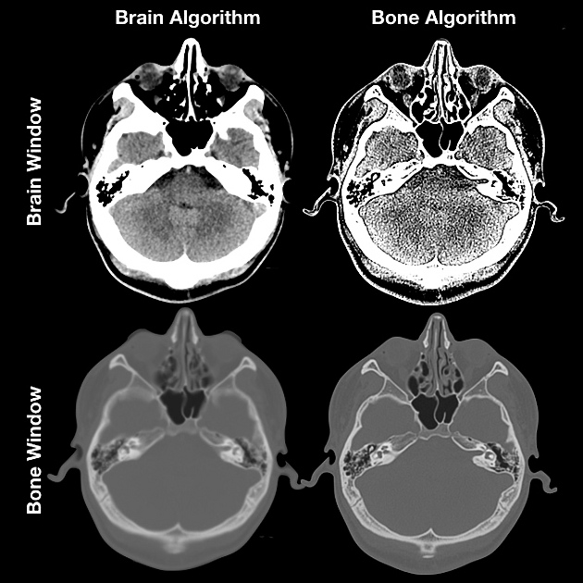

Slide 27
Post Processing
Acquired scan data …. Gathered into single volume set … reconstructed.
1. MPR ( multi-planar reconstruction )
2. CPR( curved -planar reconstruction )
3. MIP ( maximum intensity production )
4. MinIP( minimum intensity production )
5. CT rendering:
SR (surface rendering )
VR (volume rendering )

Slide 28
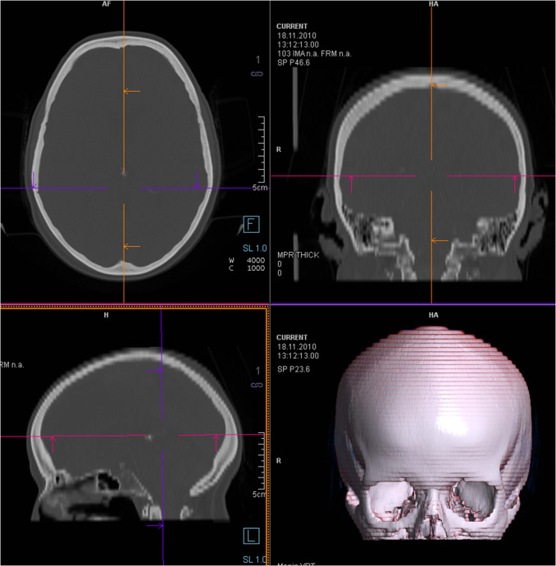

Slide 29
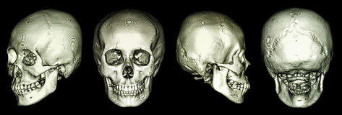

Slide 30


